Slide 1
Experience the Power of NFT Development
Block Unlock
Dilum Bandara
| Senior Research Scientist
| Architecture & Analytics Platforms (AAP) team
| Dilum.Bandara@data61.csiro.au
Notes:
In tutorials/labs, we already started developing smart contracts.
In this topic, we take a bit of a theoretical view of smart contracts and their interactions with the real world.

Slide 2
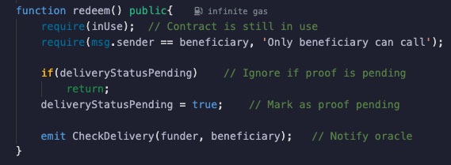
Smart Contracts
Blockchains can execute programs called “Smart Contracts”
User-defined code, deployed on & executed by whole network
Bunch of if/then conditions that represent business logic algorithmically
Can maintain its state in the ledger
Can hold & transfer digital assets, managed by the contract itself
Put counterparty obligations & rights in code, & blockchain nodes enforces those rights
Analogy – Java program
Smart contract code – a class
Deployed contract – an object

Slide 3



Life of a Program on the Ledger
User records a SC on ledger, as part of a TX
User executes the SC, in another TX – Uses data already on ledger, plus user inputs on TX – Outputs are stored on ledger, plus outputs visible to user
Other users can inspect the SC, data, & execution results
– What they see depend on permissions

Slide 4
Why Trust Smart Contracts?
Code is deterministic
Same ledger state & inputs result in same state changes & outputs
Execution is only triggered via a TX
A SC can invoke other SCs
Why can SC execution be trustworthy?
A contract is deployed as data in a TX → Immutable, transparent, & deterministic code
All inputs are through TXs & current ledger state → Transparency & integrity

Slide 5
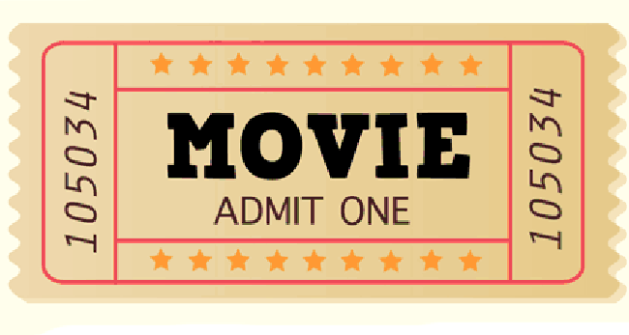
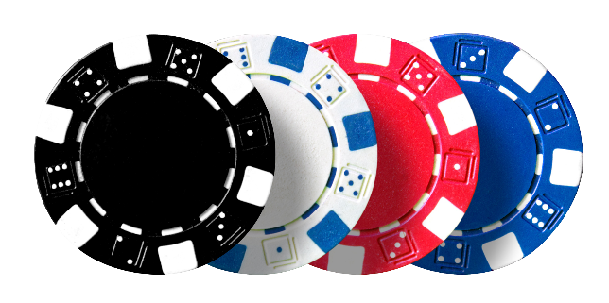
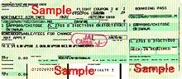
Tokens
Assets you can hold, not to be copied, to
Use once or Reuse?, Transfer?, or Sell?
Token issuer says it represents
Authorisation?
A license to use or do something?
Ownership of property?
“Any digital representation of an interest, which may be of value, a right to receive a benefit or perform specified functions, or may not have a specified purpose or use” – European Securities and Markets Authority
Tokenisation – Method that converts rights to an asset into a digital token, usually on a DLT

Slide 6
Cryptocurrency vs Tokens
Cryptocurrencies & tokens are both digital assets, on a shared ledger
Cryptocurrency | Tokens
Is baked into blockchain platform by developers, aka native currency | User-programmable in smart contracts
Accounting & validation rules are hard-coded in the platform’s base layer | Accounting & validation rules are defined in token smart contract(s)
Not centrally issued, e.g., Bitcoin & Ethereum | Centrally issued by someone, e.g., Tether & Mintable NFTs
Don’t represent other rights/assets | Represent some kind of rights
Usually only on public blockchains | Usually on public & private blockchains

Slide 7

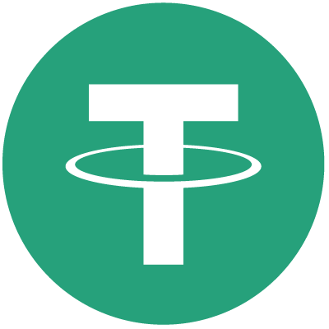

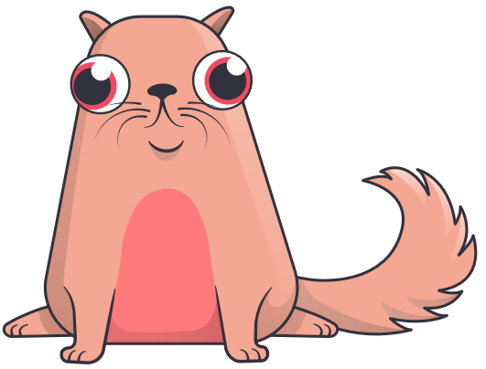


Fungible vs Non-Fungible Tokens
Fungible tokens
Identical & interchangeable
E.g., $2 coin, $10 note
Can be split
Main concern: How many?
Non-fungible tokens (NFTs)
Unique
E.g., houses, art, patents
Can’t be split
Main concern: Which ones?
Binance Coin
(BNB)
Tether USD
(USDT)
Perth Mint Gold Token
(PMGT)
CryptoKitties Dragon
$1.3M
Bored Ape #2087
$2.3M
Beeple’s opus
$69M

Slide 8
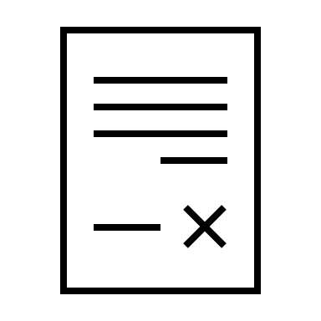


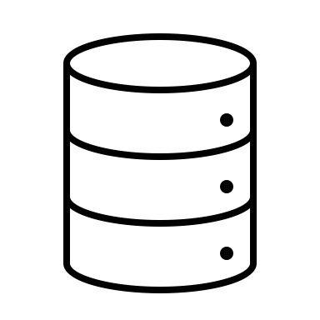
Hands On
ERC-721
Deploy contract
Mint NFT
URI

